Slide 1
MUNCH
Progress Report #5
Gabriel Soares & Gabriel Mendonca

Slide 2
Table of Contents
01
02
03
04
Timeline
Dataset Review
Website Demo
Questions?
Notes:
Soares

Slide 3
01
Timeline
Notes:
Soares

Slide 4
Project Timeline
Week 1-2 (Feb 20 - Mar 5)
Finalize Restaurant Search V1.
Setup GitHub and Trello for tasks.
Finalize entire project concept and decide what features the app will have + tech stack to build.
Week 7-8 (Apr 3 - Apr 16)
Finalize Llama search V2 (Review dataset search for better ranking).
Prototype of the overall app for testing.
Integrate Backend and Frontend
Week 3-4 (Mar 6 - Mar 19)
UI/UX Design: Draft initial Figma designs and user flow wireframes.
Optimize restaurant search V1 - Expand filtering capabilities and polish LLM response structure.
Week 9 (Apr 17 - Apr 23)
Finalize frontend development.
Conduct intense testings on the search feature and polish the algorithm/add missing features.
Polish UI and UX designs.
Week 5-6 (Mar 20 - Apr 2)
Finalize development of backend infrastructure.
User authentication implemented.
Basic frontend version working.
Figure out data storing and app hosting
Week 10-11 (Apr 24 - May 1)
Fully ready V1 of the app.
Address any remaining issues or bugs.
Present final project & collect feedback for improvements.
Notes:
Soares

Slide 5
02
Dataset Review

Slide 6



Dataset Issues
Yelp Dataset
Free for academic use, the Yelp Open Dataset requires compliance with Yelp's non-commercial terms.
Contains data on 7 million reviews, 150,000 businesses, and user interactions across 11 metro areas.
Offers detailed insights including user tips, business attributes, and check-in data for consumer and business trend analysis.
OpenTable
Sourced from OpenTable's platform, the dataset contains detailed user reviews and restaurant ratings.
It covers over a decade, from 2009 to 2023, reflecting long-term user engagement and dining experiences.
Includes specific user identifiers and textual feedback, crucial for in-depth customer sentiment analysis
DOHMH MenuStat
Provides an interactive online database of nutrition and menu information from leading national restaurant chains
Updated 2 years ago, ensuring relatively recent and relevant data for trend analysis and research
Ideal for studying nutrition trends, menu changes over time, and the impact of dietary choices on public health
TFI Dataset
TFI's dataset covers revenue for over 100,000 restaurants, good for business analysis
It includes key details like opening dates and location for in-depth market studies
Suitable for commercial use, it aids in forecasting and business strategy in the restaurant industry

Slide 7
03
Website Demo

Slide 8


Slide 9
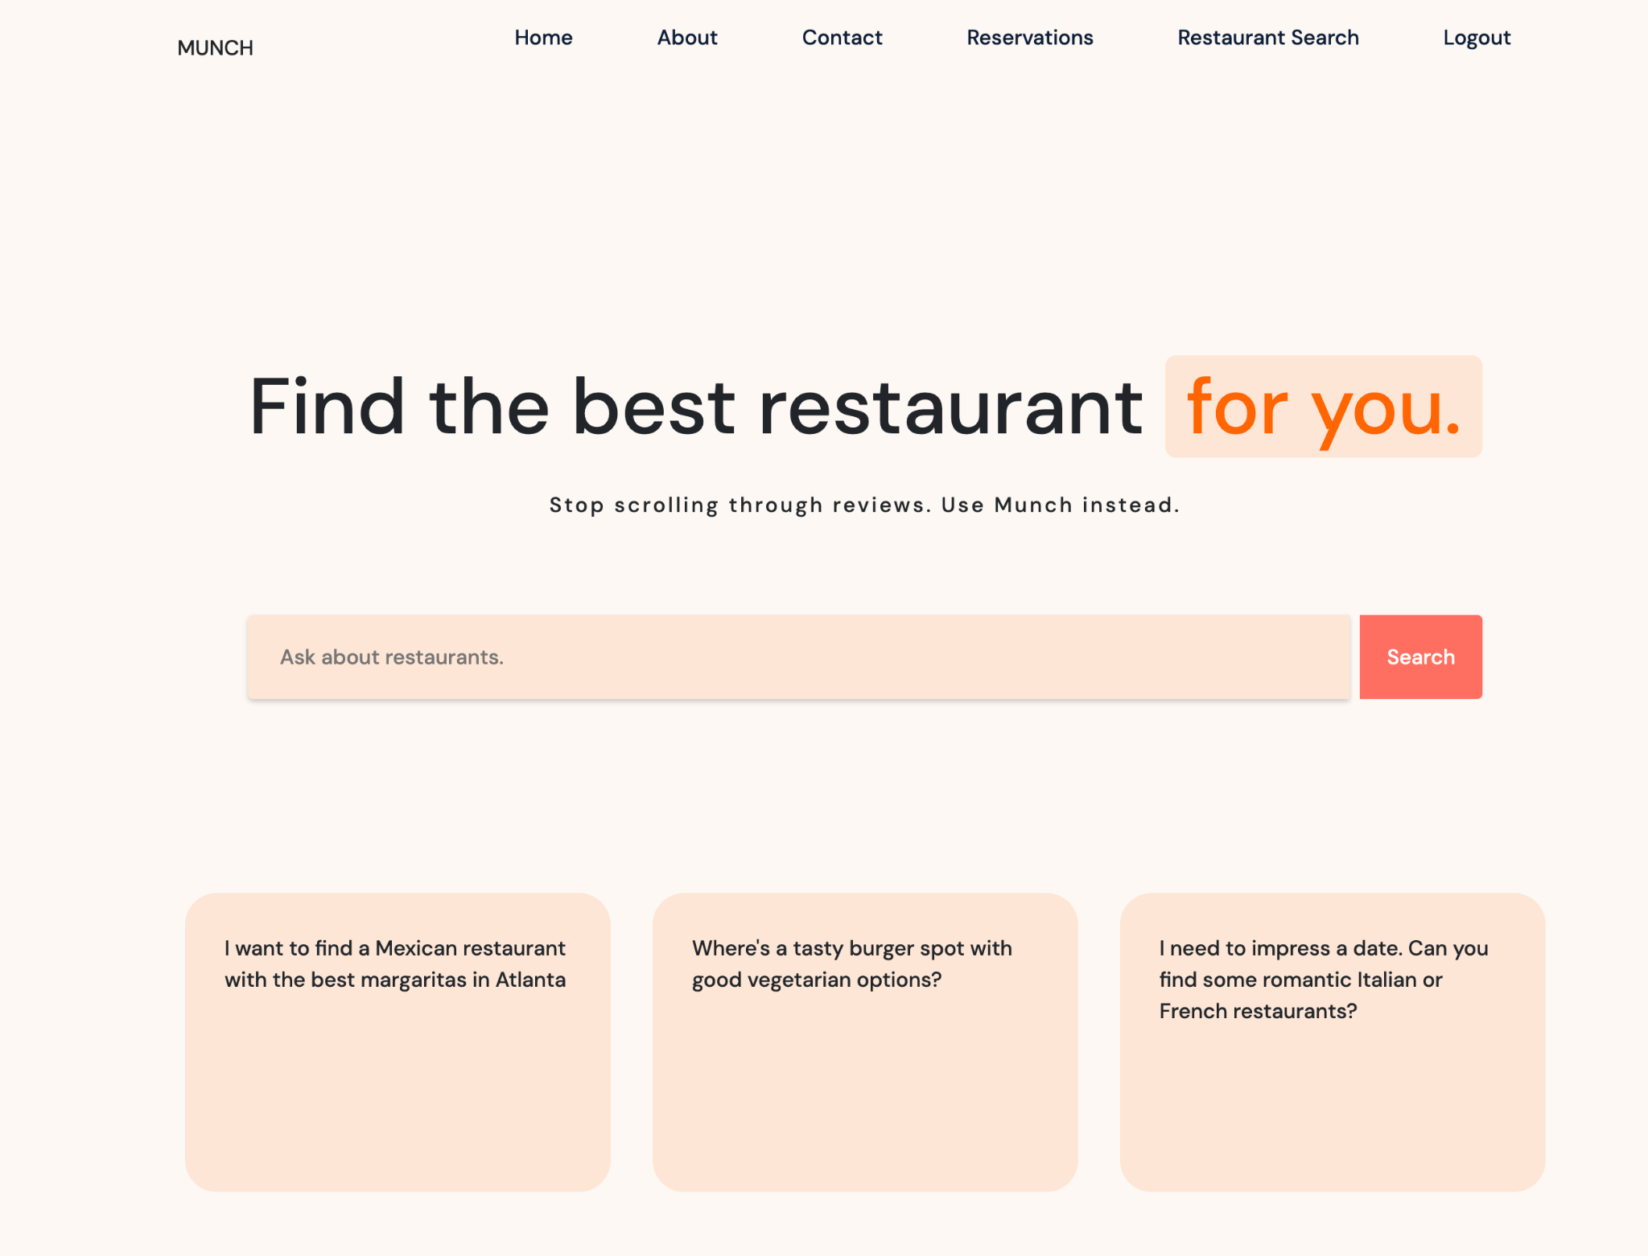

Slide 10
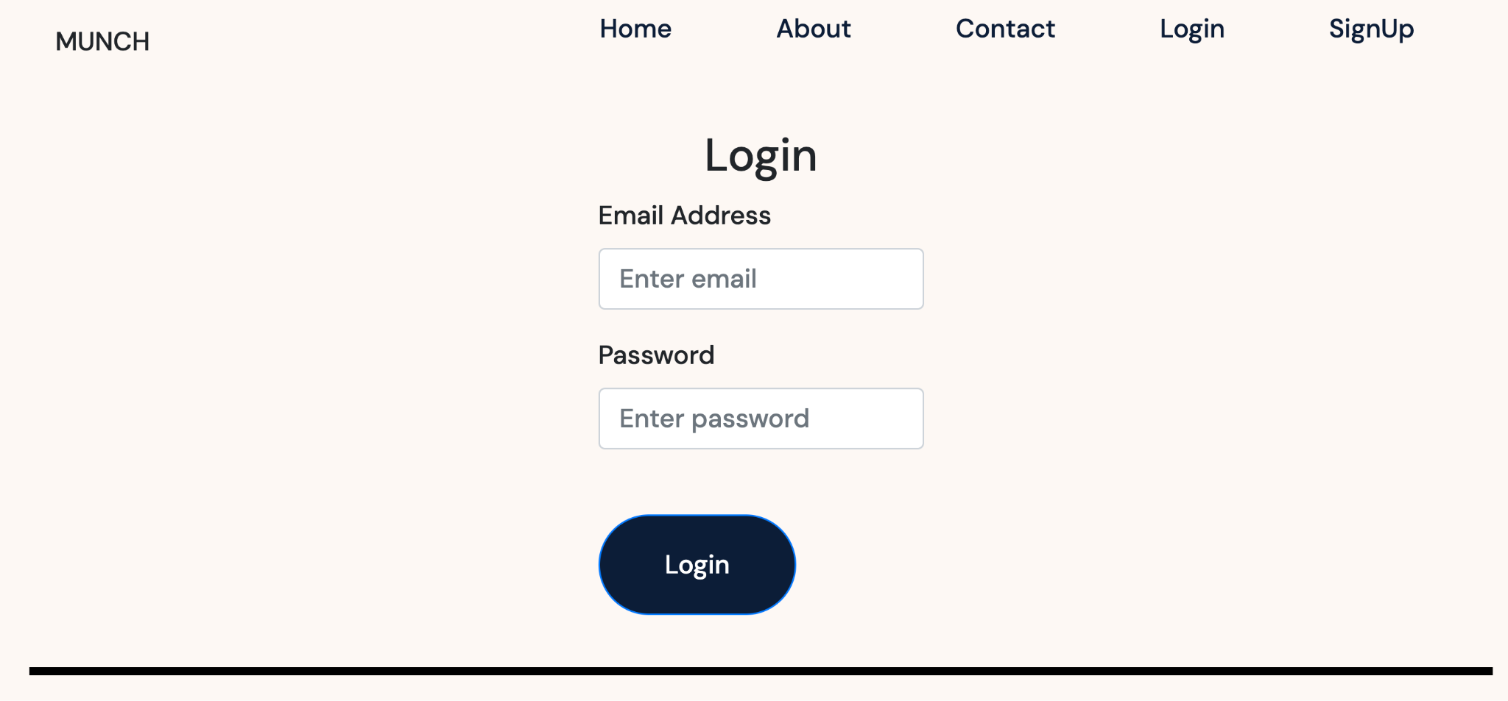
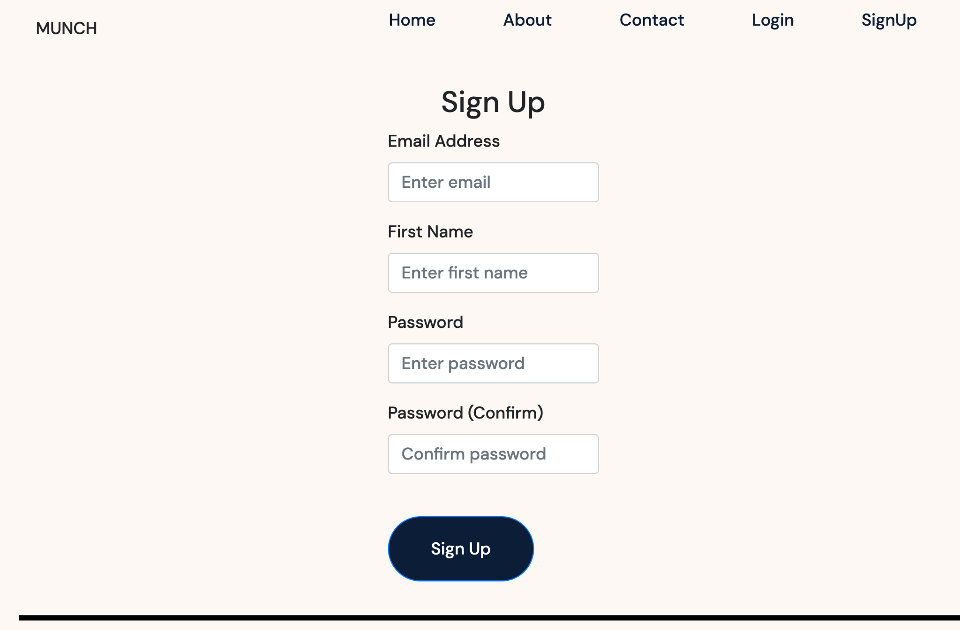
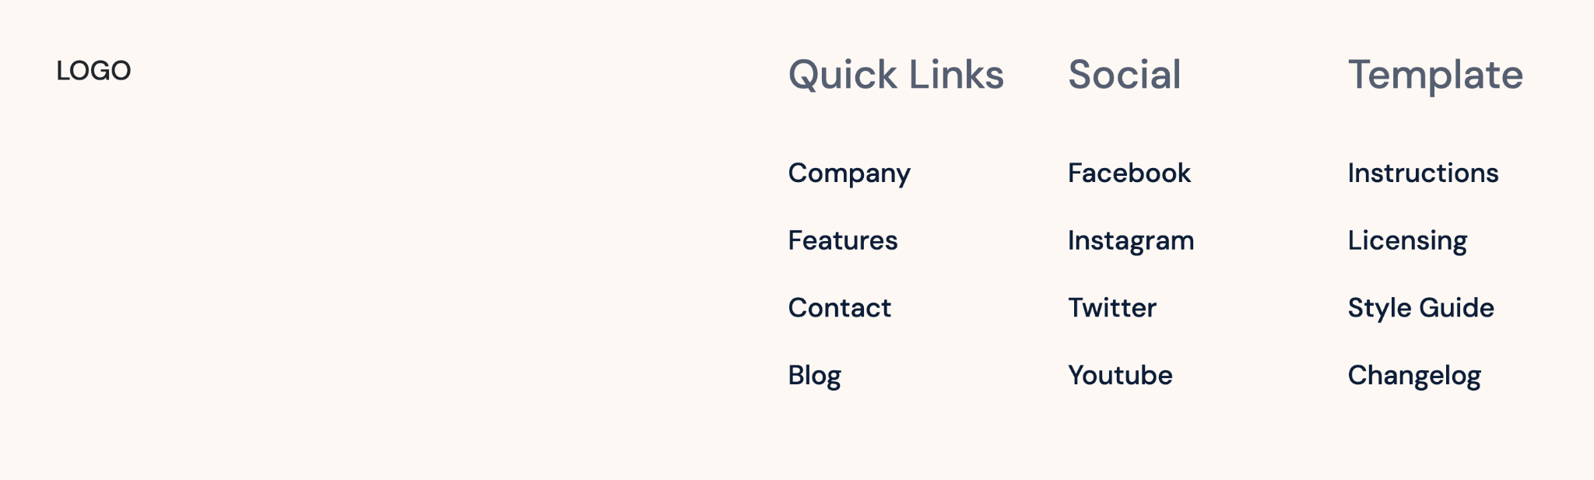
Authentication Pages

Slide 11
Thanks!
Questions?

